Slide 1

Green Pace
Security Policy Presentation
Developer: Trevor Mickelson
[Complete this template by replacing the bracketed text with the relevant information.]

Slide 2

OVERVIEW: DEFENSE IN DEPTH
My security policy will add an overall layer of security to the system. This will be through the use of core principles, and largely security coding standards, as the majority of it is heavily focused on the software side of things.

Slide 3
THREATS MATRIX
Threats
Validating User Input: This one is very likely, and can be very important, as it’s a better user experience, and it’s much more secure because the backend code that uses that validated input can actually trust what it’s interacting with. | SQL Injection: This is very likely to occur, and should be considered a high priority, as one bad leak can bring down the company overnight.
Variable Names: I consider this very low priority, as it’s not really a threat, and mostly the worst thing it can do is make code very annoying to read. It’s generally a non-issue in small doses, but if the entire code base is riddled with it, it does become a big issue. | Exception Handling: This one should just always exist, without handling exceptions/errors within the code, there will be a large number of runtime errors, and places where the code won’t work. This could cause major security issues.

Slide 4
10 PRINCIPLES
Validate Input Data
Heed Compiler Warnings
Architect and Design for Security Policies
Keep it Simple
Default Deny
Adhere to the Principle of Least Privilege
Sanitize Data Sent to Other Systems
Practice Defense in Depth
Use Effective Quality Assurance Techniques
Adopt a Secure Coding Standard

Slide 5
CODING STANDARDS
Ranking System -> Low, Moderate, Medium, High, Urgent, Critical
Data Type: int num = 10; Moderate
Data Value (defining): int num = 0; Medium
String Correctness: std::string str = “safe string”; Urgent
SQL Injection: Use prepared statements! Urgent
Memory Protection: use delete[]! Critical
Assertions: assert(value != 0 && “Error”); Medium
Exceptions: Error catching! High
Function sizes: void loadIndividualMap(): Medium
Name Conventions: int goodVariableName; Low
Use of Constants: const double PI = 3.14159; Medium

Slide 6
ENCRYPTION POLICIES
Encryption in rest: This is encryption that is stored, but not being used. Something like a hard drive, or maybe even a USB stick. This is specifically for long term storage though.
Encryption at flight: This is encryption in transit, AKA being moved from one place to another, or from one machine to another machine. Common technologies here are things like HTTPS, SSL, and TLS
Encryption in use: This protects the data while it’s being used/processed. This is very important in cloud environments, where data is likely being shared on insecure systems.

Slide 7
TRIPLE-A POLICIES
Authentication: Verifying the identify of a user, device, or system. This is usually done when an attempt to access the system is made.
Authorization: Determines the authorization of whatever actor is attempting to connect to the system.
Accounting: This is the process of tracking user activities and resource usage, AKA this just logging in a nutshell. If everything gets locked and tracked, everything that happens in the system can be determined

Slide 8
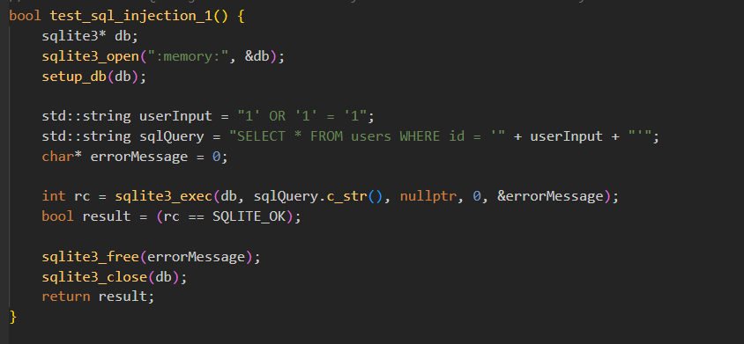
Unit Testing
The test I chose was SQL Injection.
Example 1.) Positive Test: Tests for an attacker returning true on a WHERE condition.

Slide 9
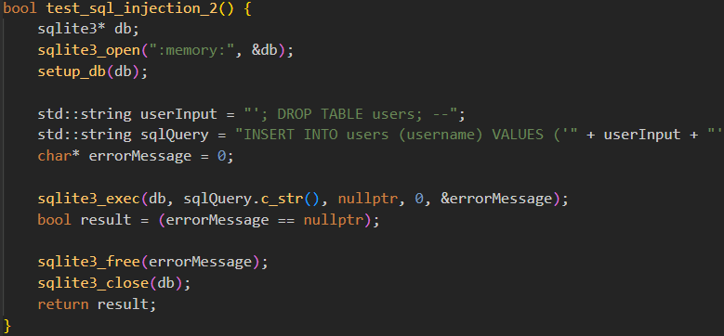
Unit Testing
Example 2.) Positive Test: Tests for an attacker attempting to drop a table from the database.

Slide 10
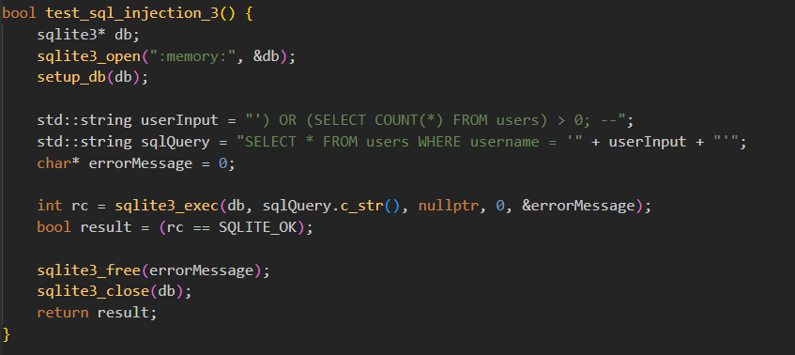
Unit Testing
Example 3.) Positive Test: Tests for an attacker manipulating WHERE conditions using sub-queries.

Slide 11
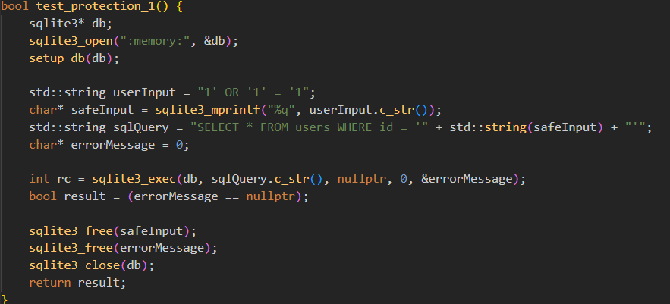
Unit Testing
Example 4.) Negative Test: Tests by escaping user input, so the injected SQL acts as plain text.

Slide 12
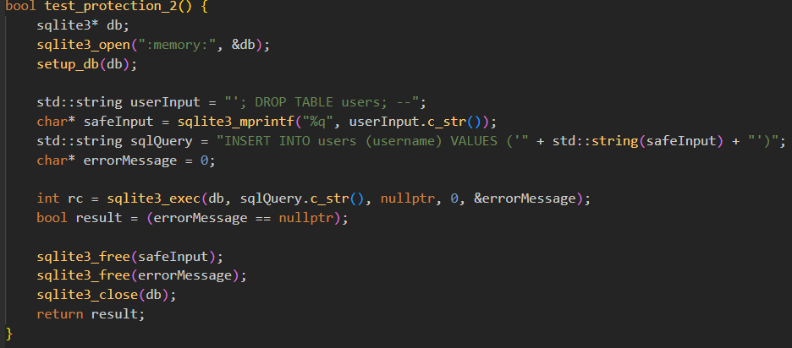
Unit Testing
Example 5.) Negative Test: Ensuring that injected DROP TABLE commands act as plain text and aren’t executed.

Slide 13
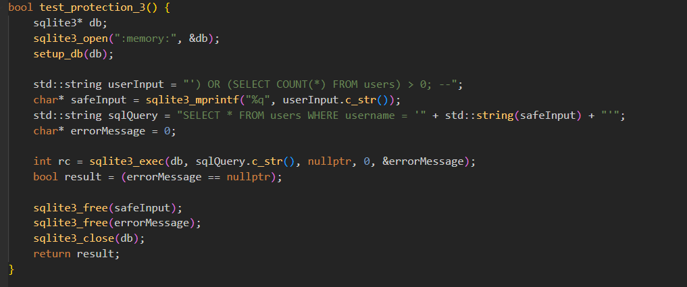
Unit Testing
Example 6.) Negative Test: Escaping user input to control sub-query manipulations.

Slide 14

AUTOMATION SUMMARY

Slide 15
TOOLS
Generally, most of the tools depicted here are tools that are used locally on the software side of things. A lot of theme are baked into the IDE, some are external pieces of software, or even just basic APIS/Libraries. These tools are meant to add a control/secure flow to the software project. Things like UNIT testing, monitoring for decent code principles, etc.

Slide 16
RISKS AND BENEFITS
It's better to act now, rather than wait. If security isn’t considered until the end, then there’s a potentially massive codebase/tangled system to now try to add security to. The better approach here is to take security into consideration in the beginning, and just follow basic security principles while building the system.

Slide 17
RECOMMENDATIONS
I think the biggest gap missing here is a transitional gap. Doing everything perfect from the beginning is a luxury most companies don’t get, the hard part isn’t building a “perfect” system, the hard part is transitioning an existing system to something new. There needs to be a plan for executing all the new standards and principles into the existing code base, and training the software developers to follow them regularly, and a way to monitor these things are being followed.

Slide 18
CONCLUSIONS
I think the principles already stated should be followed to prevent future problems, but it should also be done in a way that doesn’t just destroy the old code base/requiring rewrites, or stop updates from happening.

Slide 19
REFERENCES
N/A

